Slide 1
Analysis, Design and Implementation
Topic 10:
Redesign and Implementation
Notes:
NCC Education - Title Master

Slide 2
Introduction
  In Topic six, we worked through a design case study for a vehicle management service.
  In this topic, we are going to look at issues of implementation that go with the scenario.
  We have a number of new tools in our toolkit. These are our design patterns.
  We should examine each of the things our system will have to do, and identify if we need to adjust our design to accommodate.

Slide 3
Refactoring
  Refactoring is the process of improving things that already exist.
    We’ll talk more about this in the next topic.
  We want to refactor our design so that it is as well engineered as it possibly can be.
    This is part of the iterative nature of analysis and design.
  This process falls a little between design and implementation.
    We need to know about our implementation context.

Slide 4
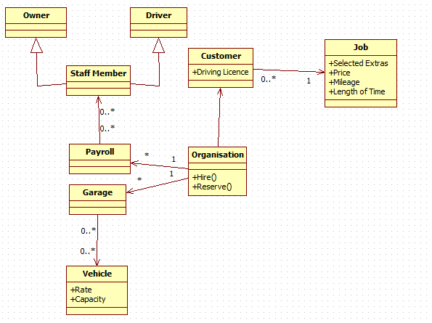
Our Design so Far – Classes

Slide 5
Assessing the Design - 1
  Our first step is to look at where we can refactor our class diagram in light of what we now know about high quality software.
    Assess for coupling and cohesion
    Apply design patterns in light of requirements
  Our system is data coupled for the most part, but not heavily so.
    That’s good, but it perhaps it could be better.
    It will require some redesign.

Slide 6
Assessing the Design - 2
  Although we do not have methods and attributes defined, we can be reasonably certain cohesion is high.
    Each class has a narrowly defined responsibility.
    The existence of classes like Payroll and Garage show that there is a proper separation between ‘representing a unit’ and ‘representing the collection of units’
  We may want to reconsider the class diagram in light of designing for software components.

Slide 7
Redesigning
  Redesigning is not a scientific process.
    There is no right answer, although there are plenty of wrong answers.
  Opinions will vary on how to approach a particular redesign .
    Everything involves trade-offs.
  Even choosing to use a design pattern is a trade-off.
    Extra flexibility versus an increased class count and all that is associated.

Slide 8
Component Design - 1
  Software component design would require us to break this system up into three parts:
    Vehicle Management
    Staff management
    Customer management
  Each of these would be linked into the Organisation class.
  We could usefully use a facade here to implement our black box. Is this good design?

Slide 9
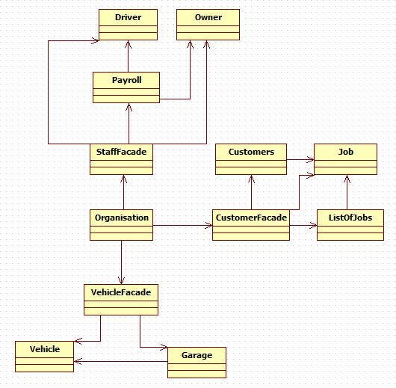
Component Design
Component design here introduces three new classes, and a large amount of additional coupling. Our three new classes have low cohesion.
Not appropriate for this project.

Slide 10
Design Patterns
  Component design introduces more problems than it solves in this example.
    It comes into its own when discussing much larger projects.
  What about our design patterns?
  Are any appropriate here?
  Starting from our original design, we can start to look at the functionality we have identified and determine where they are appropriate.

Slide 11
The Model View Controller - 1
  The MVC architecture is one that we should always be looking to use.
  In our case, all we have at the moment is our model. However, we have also been told we must implement front-ends in both desktop and web form.
    Thus, we need to expand our system a bit to include this.
  These new classes will be two separate view/controller classes.
    They do the same thing, just in different ways.

Slide 12
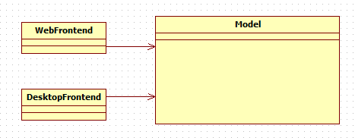
The Model View Controller - 2
How do the View/Controller classes interact with the model?
We’d want to expose a facade from our model to permit this.

Slide 13
The Facade
  When creating a black box component, we must hide implementation details.
    Otherwise, parts of the system become structurally dependent.
  We can do this in our model behind a facade.
    Note that while the Organisation class ties together all of our system, it’s not a facade.
    The roles performed by the classes are different.
      Organisation ties things together.
      The facade simplifies the API and creates an interface.

Slide 14
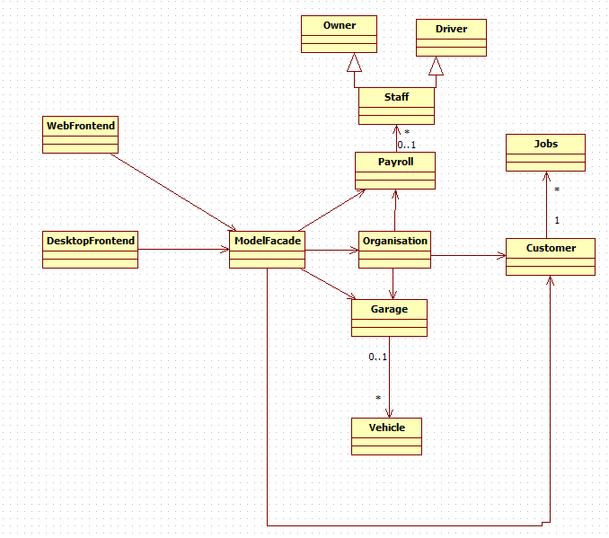
Modified Design
We gain our facade as an entry point and exposed interface to our model.
It’s a highly coupled class with low cohesion, but that is the cost we must pay.

Slide 15
The Factory Design Pattern - 1
  We are presumably going to be creating a number of jobs as we go along.
    We perhaps want to create a job factory that:
      Creates the job based on the data we are given
      Assigns it to the customer
  Likewise for vehicles:
    Creates vehicle objects using the details we give them.
  We should consider a factory whenever we are creating many instances of an object with complex configuration.

Slide 16
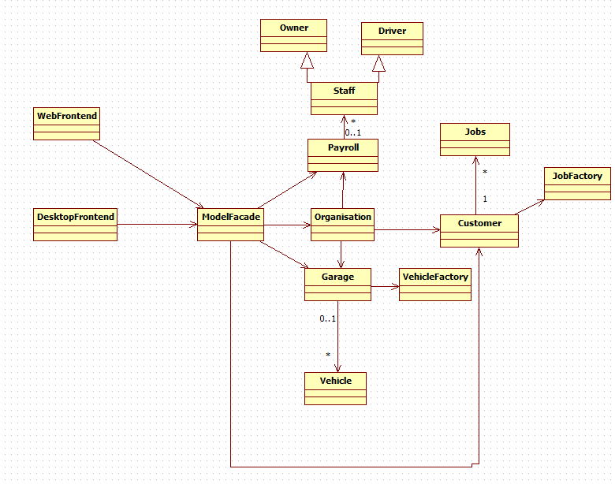
The Factory Design Pattern - 2
There is no need for our factories to be complex.
We can have them as classes with static factory methods if we desire.

Slide 17
The Strategy Pattern
  We don’t have a lot of need here for implementing a strategy pattern.
    Not all patterns are useful everywhere.
  We could use a strategy pattern to create a flexible link between the logic for hiring a vehicle and hiring a driver.
    We must consider what we would really gain from this versus the cost.
  It is perhaps not suitable in this project.

Slide 18
The Flyweight Pattern
  Most of the objects we create have context to go with their state.
    There is a difference between Vehicle 1 and Vehicle 2, in that they will be assigned to different drivers and jobs.
  Flyweight objects are useful only if they are identical in all respects and free of context.
  The flyweight has no appropriate role in our project. Thus, we don’t include it.

Slide 19
The Observer Pattern - 1
  The Observer pattern has a role in most programs.
    It lets us implement callback coupling.
  However, the benefit gained from this is often not worth the cost of increased object and class complexity.
  We can profitably implement this as the primary mechanism for communication between our model and the facade however, and we should do this to remove structural dependencies.

Slide 20
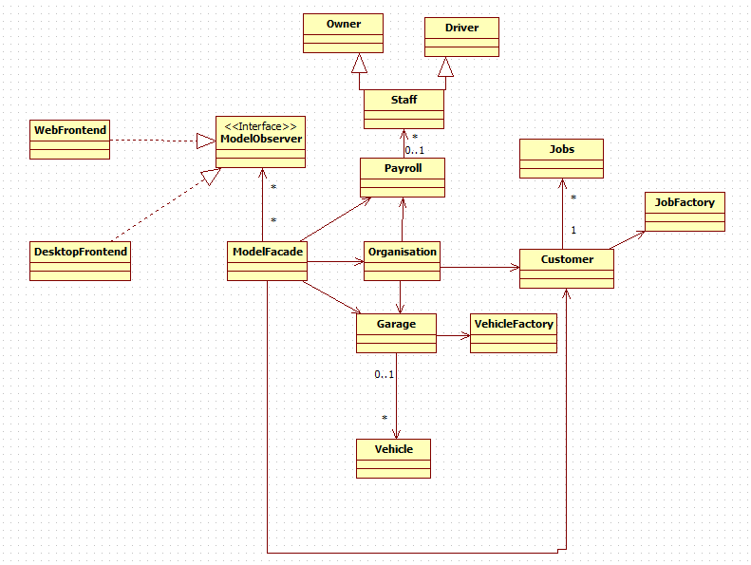
The Observer Pattern - 2
Here we add in an interface class, and have the front-end classes implement it.
In this way, we have obtained the loosest coupling between the model and the view/controller.

Slide 21
Implementation - 1
  We now have a class diagram that we can convert into code.
    We know what role each of the classes are going to play.
    We know where we are using design patterns to their best effect.
  Converting an activity diagram into code is the same process as turning pseudocode into code.
    We have discussed this process already.
  Our class diagram is a little more complex.

Slide 22
Implementation - 2
  Our class diagram omits attributes and operations.
    We have already discussed how these should be handled.
    Fleshing out the diagram with these is left as an exercise for students.
  Our first step in implementing a class diagram is to sketch out the classes in code.
  We start with classes that have no dependencies, so that we can compile as we go along.

Slide 23
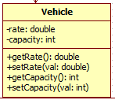
Vehicle Implementation
public class Vehicle {
private double rate;
private int capacity;
public void setRate(double val) {
rate = val;
}
public double getRate() {
return rate;
}
public void setCapacity (int val) {
capacity = val;
}
public int getCapacity() {
return capacity;
}
}

Slide 24
Implementation - 3
  Implementing a base class like this allows us to then implement dependent classes, such as the VehicleFactory.
  Our factory is going to take in the parts of the vehicle that must be configured, and then spit out a configured object.
    This will be done as a static method so as to avoid the need to instantiate an object.

Slide 25

Implementation of Factory – 1
public class VehicleFactory {
private static final int TYPE_TRANSIT = 0;
private static final int TYPE_COMBO = 1;
private static final int TYPE_BOX = 2;
public static Vehicle getVehicle (int type) {
return null;
}
}

Slide 26
Implementation of Factory – 2
public static Vehicle getVehicle (int type) {
double rate = 0.0;
int capacity = 0;
Vehicle v = new Vehicle();
switch (type) {
case TYPE_TRANSIT:
rate = 2.0;
capacity = 2000;
break;
case TYPE_COMBO:
rate = 1.5;
capacity = 1000;
break;
case TYPE_BOX:
rate = 3.0;
capacity = 5000;
break;
default:
return null;
}
v.setRate (rate);
v.setCapacity (capacity);
return v;
}

Slide 27
Implementation - 4
  Then, we can implement the class that requires the existence of our factory – the Garage
  We need to decide on how the Garage is going to store vehicles.
    We’ll use a HashMap for the this.
  Our HashMap will store vehicle objects by licence plate.
    This give us an easy way to query specific vehicles.

Slide 28

Garage Implementation
public class Garage {
HashMap<String,Vehicle> myVehicles;
public Garage() {
myVehicles = new HashMap<String,Vehicle>();
}
public void addVehicle (String licence, int type) {
Vehicle v = VehicleFactory.getVehicle (type);
myVehicles.put (licence, v);
}
}

Slide 29
Implementation - 5
  Implementation progresses like so:
    Create base classes
      Implement their logic.
    Create dependent classes
      Link them to the base classes.
  You do not need to implement all functionality at once. You can approach the development incrementally.
    We still need to implement functionality for removing vehicles, for example.

Slide 30
Conclusion
  Analysis and Design is an iterative process.
    We need to revisit our designs as we learn more about how to implement things.
    We need to revisit our analysis as we reveal problems with our design.
  Design patterns can be useful, but not in all situations.
  We must always be mindful of the cost of the benefits they give us.

Slide 31
Topic 10 – Redesign and Implementation
Any Questions?
Notes:
NCC Education - End Slide Master

